Slide 1

Milestone 3 - Process modelling

Slide 2
Our Team
ITI Solutions
Aidan C. - Team leader
Harley L. - Liaison officer
Justin A. - Database developer
Beryon C. - Server engineer/UX
Evan G. - Programmer/UX
Notes:
Everyone

Slide 3

Our client
Organization that provides services for people that require special assistance
Government funded/ privately funded organization
Notes:
Aidan

Slide 4
Project description
We are making a scheduling and time-tracking web application for Edenbridge.
Employees will be able to log in through an online portal for different options
Coordinators will be able to schedule workers, workers will be able to view their schedules
Notes:
Aidan

Slide 5
Project description
For time-tracking, employees will be able to submit their hours to our database
The system will then export a file that can be uploaded into their accounting software
Notes:
Aidan

Slide 6
Current system
Edenbridge's current system is paper based with Excel spreadsheets and accounting software
This system has them entering 200 + employees' timesheets manually
Notes:
Evan

Slide 7
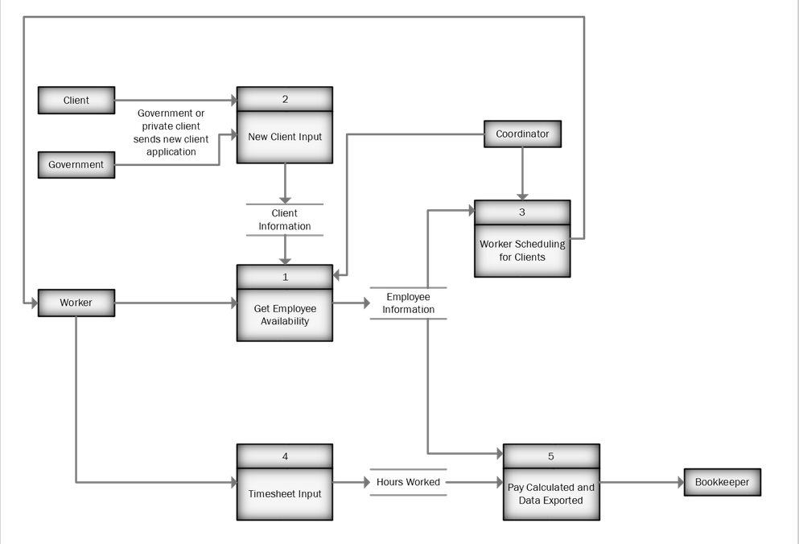
Current project process diagram level 0
Notes:
Evan

Slide 8
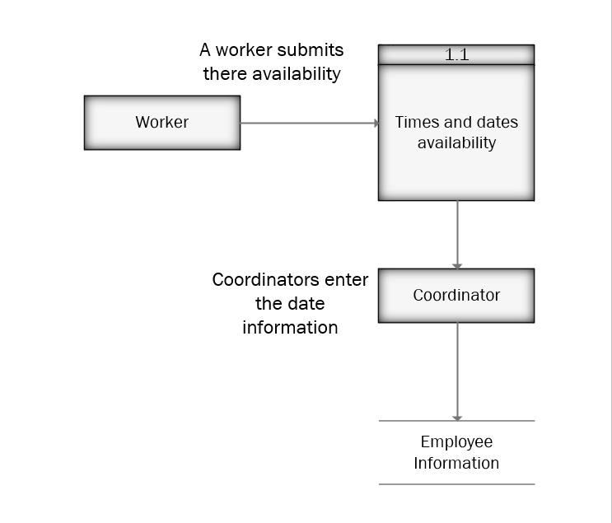
Current 1 system level 1 availability
Notes:
Evan

Slide 9
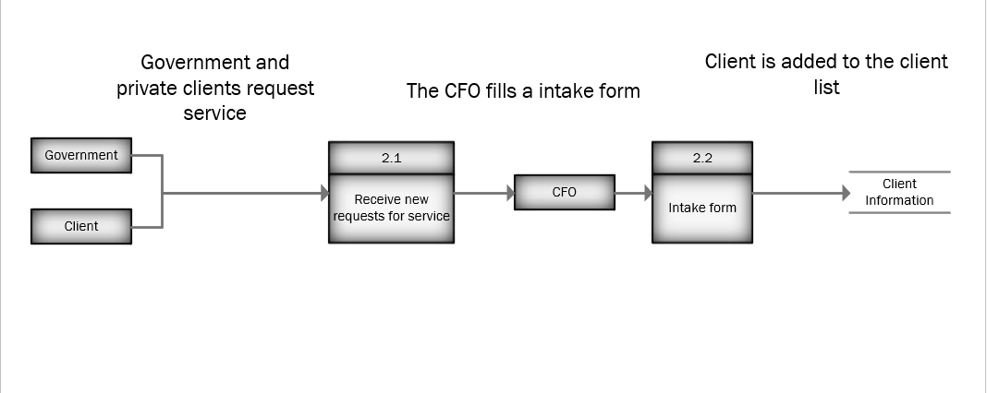
Current system level 1 client creation
Notes:
Evan

Slide 10
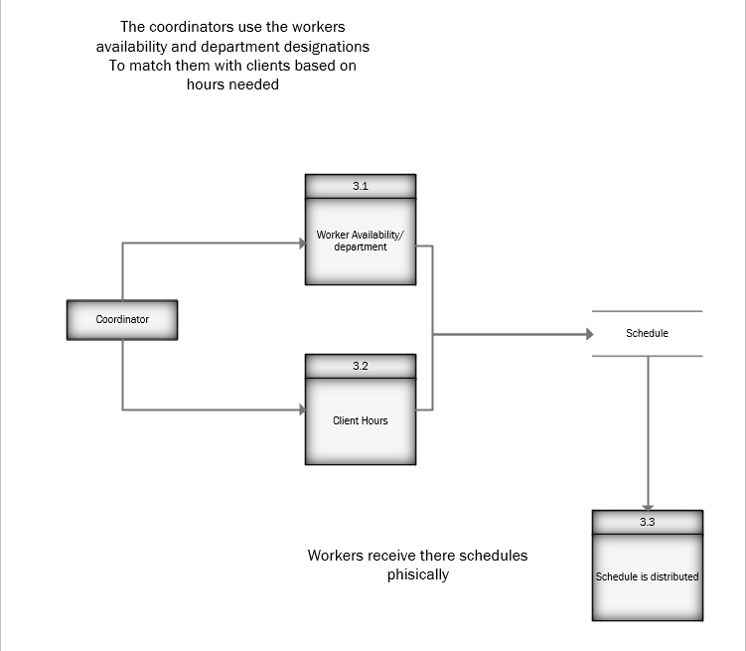
Current 1 system level 1 scheduling
Notes:
Evan

Slide 11
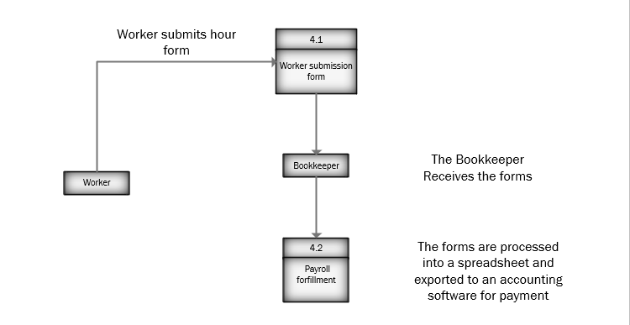
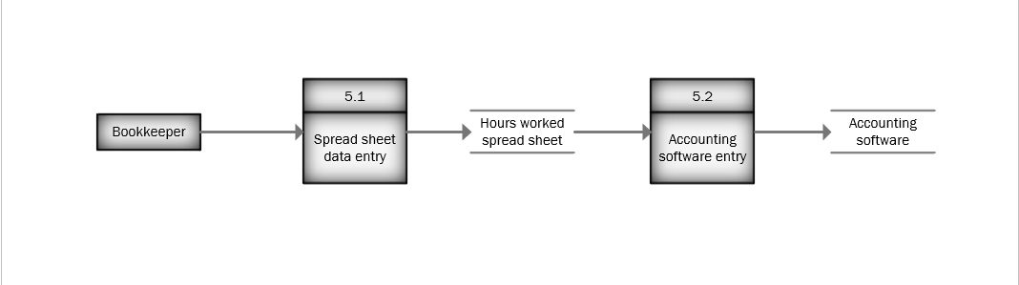
Current system level 1 Time sheets/ Payment
Notes:
Evan

Slide 12
Crud processes
 | Create/Remove Client/Employee Records | Get Employee Availability | Worker Scheduling for Clients | Timesheet Input | Pay Calculated and Data Exported
Client | C |  | U
Worker |  | CU | R | CU | R
HR | CRUD
Bookkeeper |  |  |  | R | CU
Coordinator |  | R | CRU | R
Notes:
Evan

Slide 13
Proposed system
The proposed system will be more computer-based and able to be accessed by employees easily
The system will make the currently tedious processes much more efficient
Notes:
Harley

Slide 14
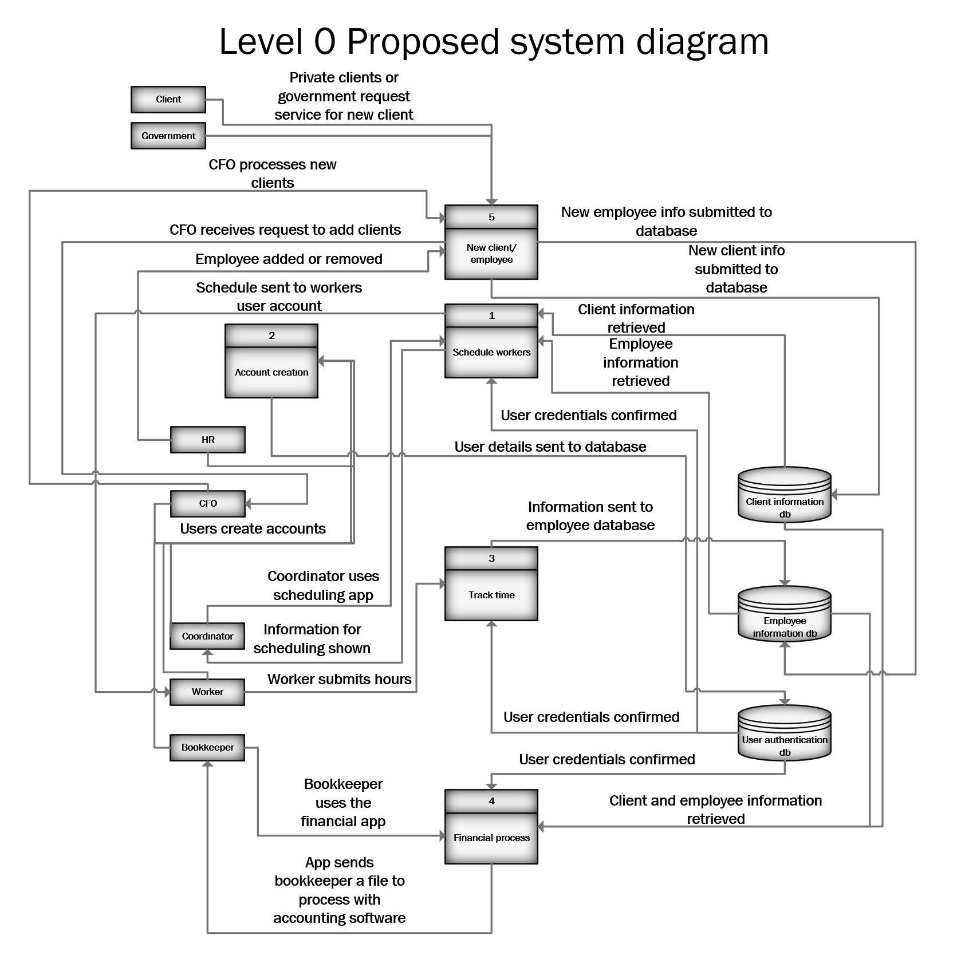
Notes:
Harley

Slide 15
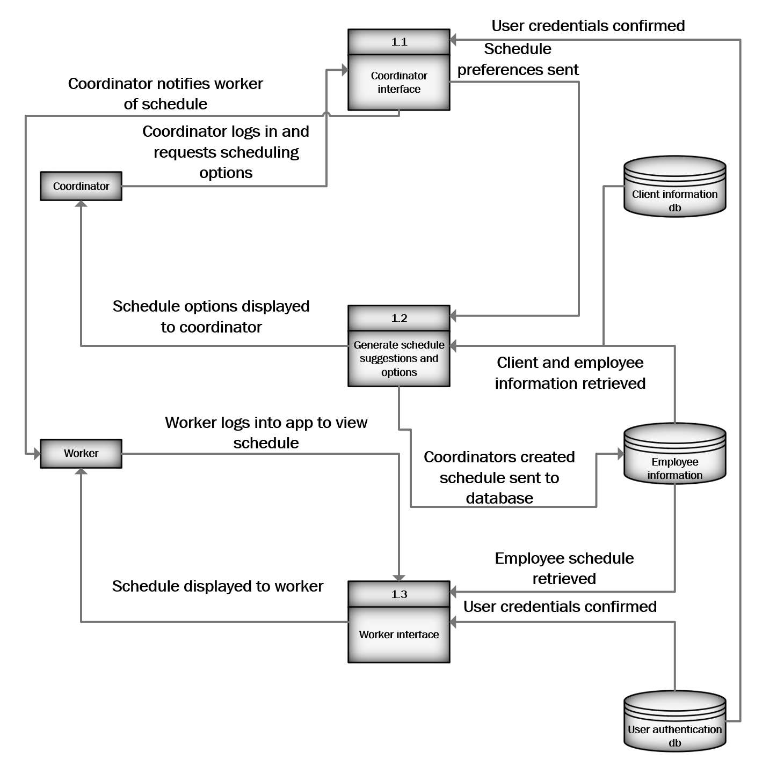
Process 1 Scheduling Workers

Slide 17
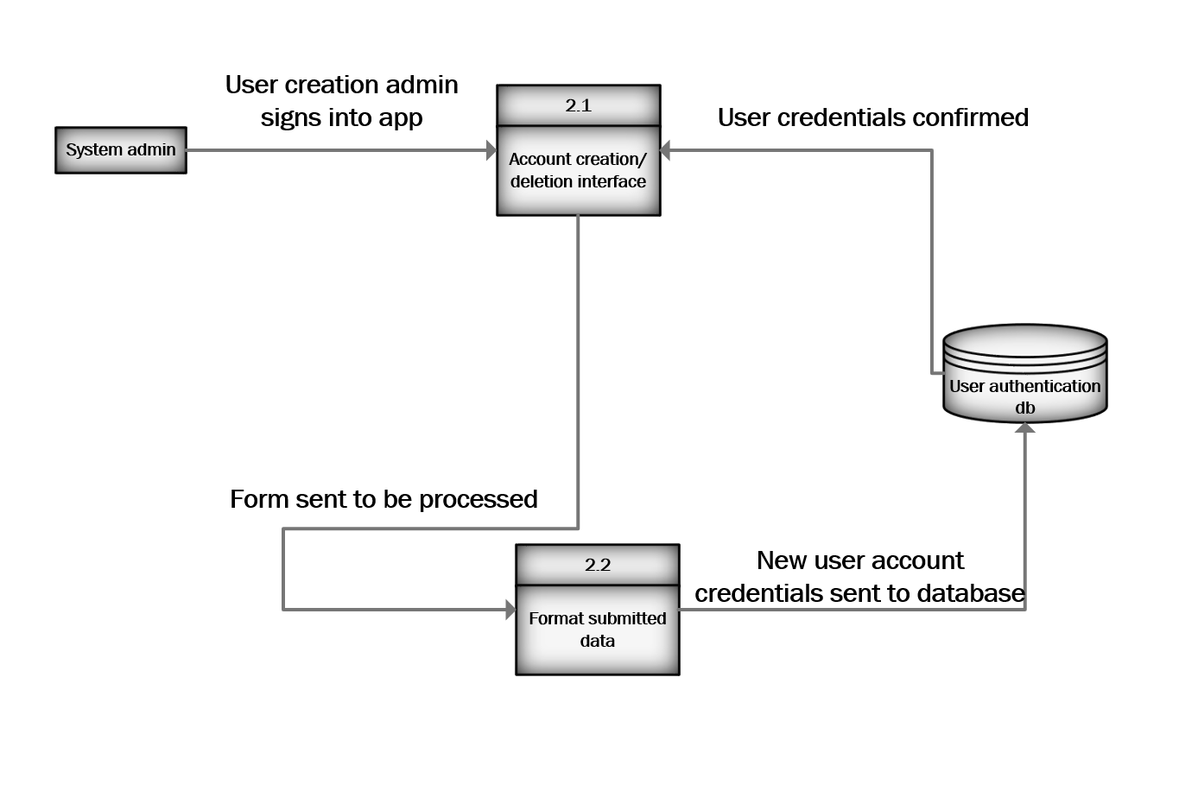
Process 2 Account Creation

Slide 19
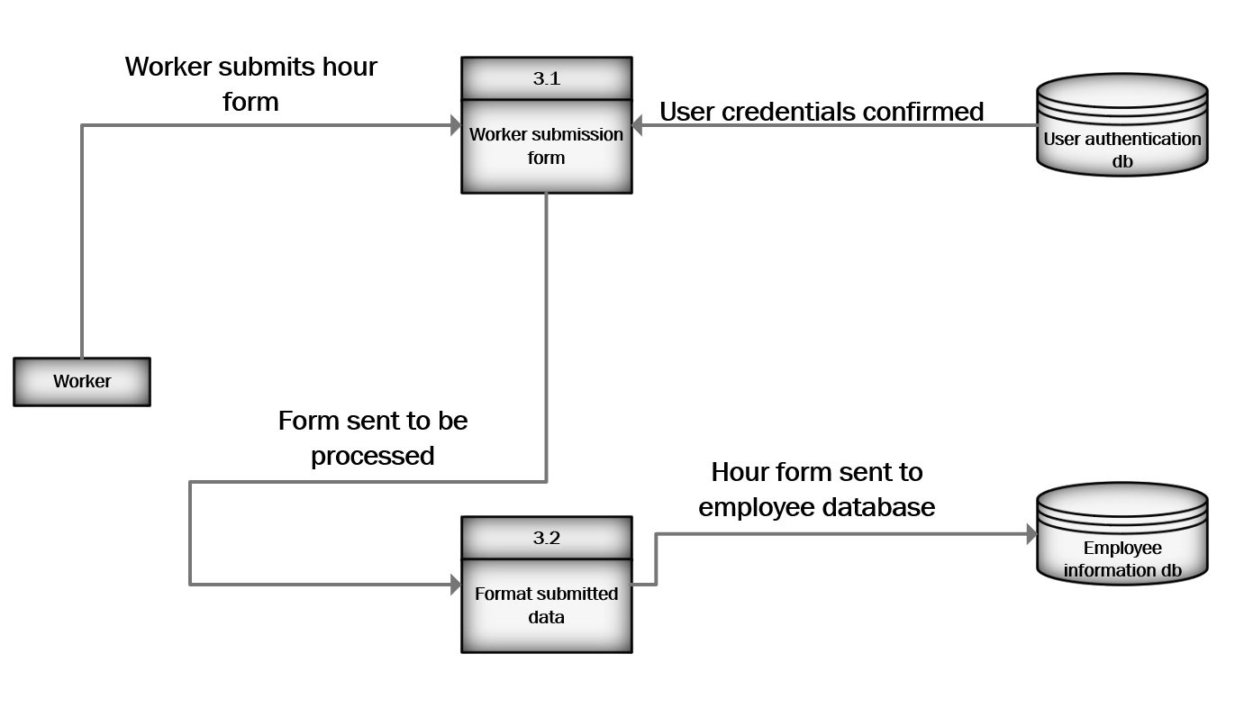
Process 3 Time Tracking
Notes:
Harley

Slide 20
Notes:
Justin

Slide 21
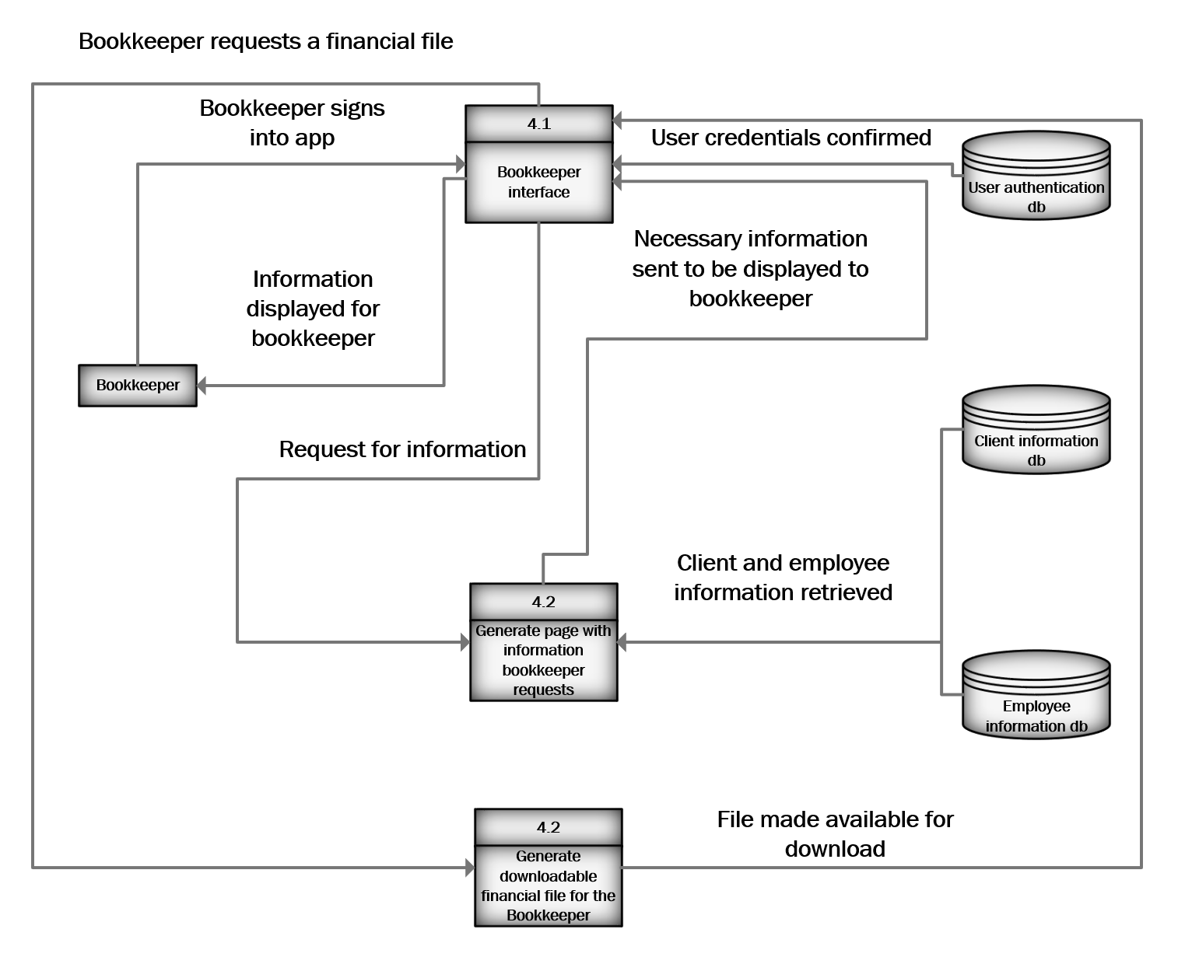
Process 4 Financial processing

Slide 23
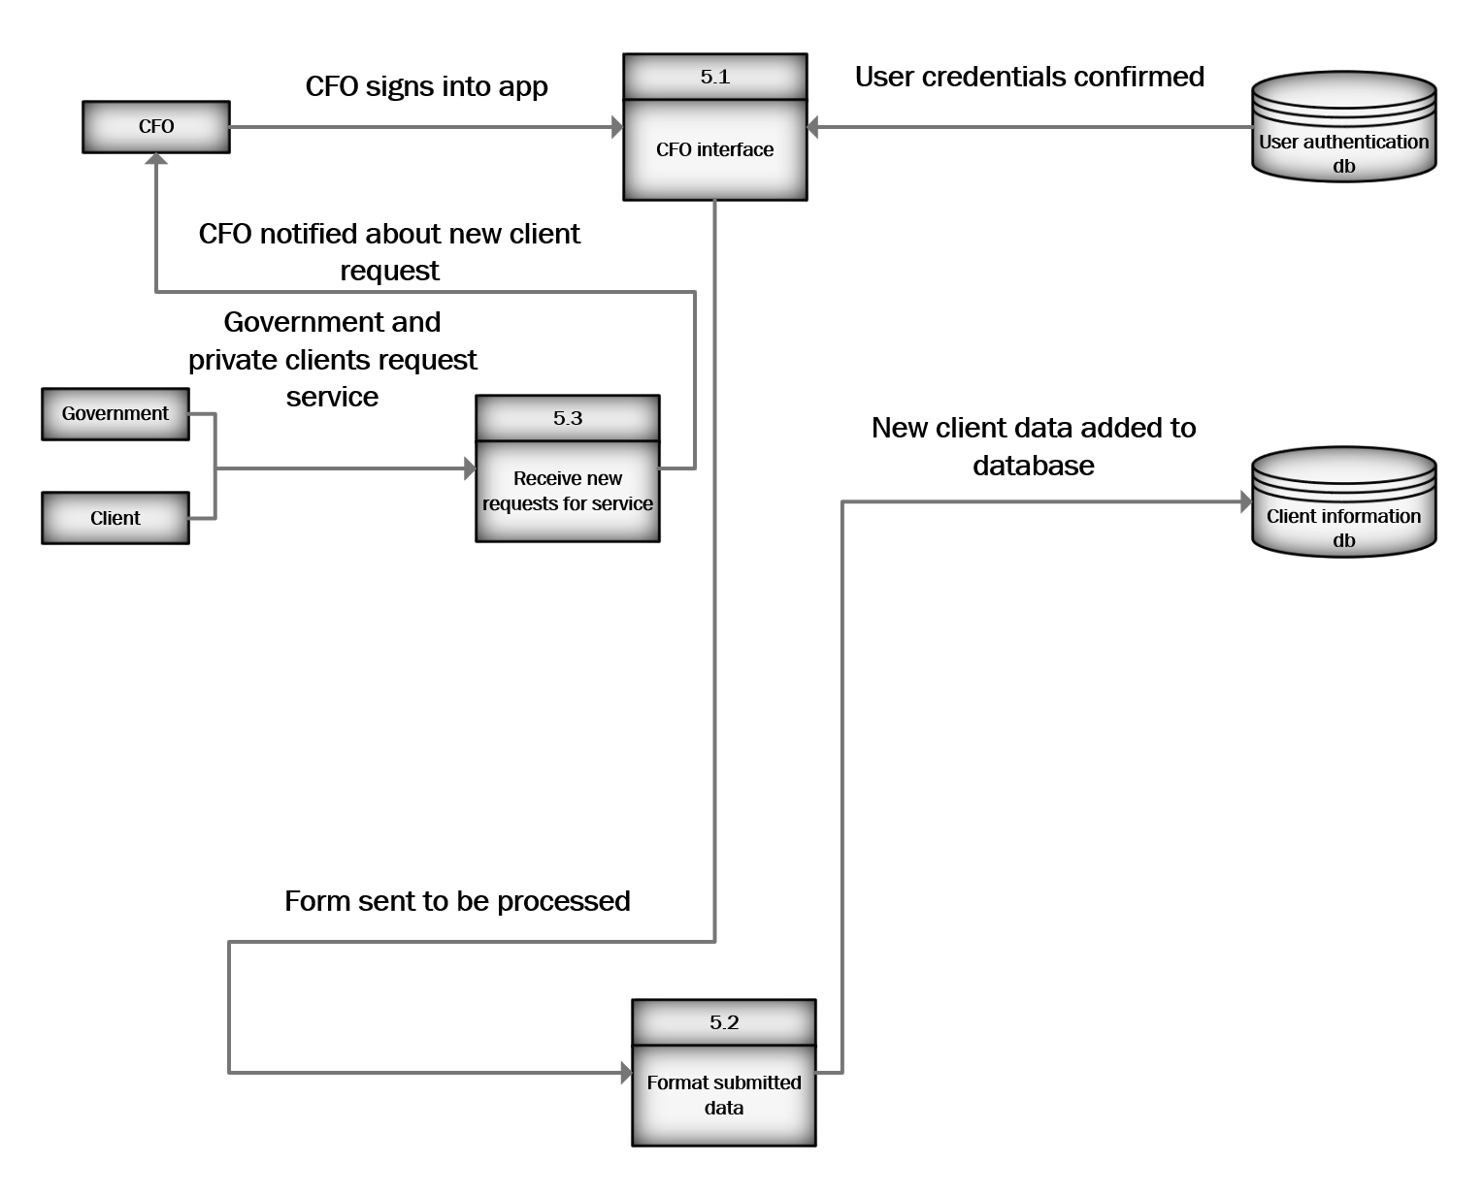
Process 5 New client or employee
Notes:
Justin

Slide 24
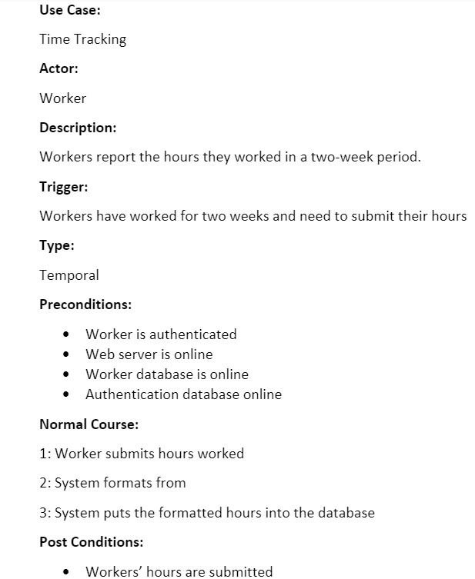
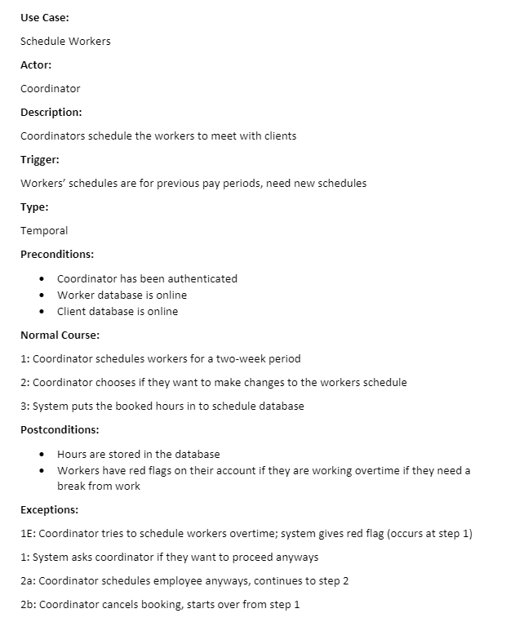
Use cases
Notes:
Justin

Slide 25
Conclusion
Edenbridge's current system is cumbersome and inefficient, with no centralized database
The proposed system would centralize data, allowing easier access and live updates
Notes:
Beryon

Slide 26
Looking Forwards
In the next short while:
Entity Relationship Diagrams for both the current and proposed data structures
Later on:
Detailed feasibility analysis
System proposal
Relatively far off:
Designing features
Beginning the implementation phase
Notes:
Beryon

Slide 27
Questions?

